Slide 1
On the Worst-Case Complexity of the Traveling Salesman Problem
Jesper Nederlof

Slide 2
Traveling Salesman Problem and Friends
Given vertices $V=\left\{1,…,n\right\}$ with distances $d\left(i,j\right)∈\{1,…,W\}$
Asked shortest roundtrip visiting all vertices once
We focus on the worst case complexity
Clean mathematical model
Expect a `wall’ towards improved algorithms (NP-completeness)
But where: $n^{\log{n}}$, $2^{\sqrt{n}}$, $2^{n/\log{n}}$, $2^{0.99n}, 2^{n}, n!$
Much recent interest in similar study for related problems (Strong ETH)

Slide 3
Traveling Salesman Problem and Friends
Given vertices $V=\left\{1,…,n\right\}$ with distances $d\left(i,j\right)∈\{1,…,W\}$
Asked shortest roundtrip visiting all vertices once
Symmetric $d\left(i,j\right)=d\left(j,i\right)$, for all $i,j∈V$
Hamilton Cycle $d\left(i,j\right)∈\{1,∞\}$ for all $i,j∈V$
Bipartite underlying graph is bipartite
$k$-path find a simple path on $k$ vertices in a graph
We skip many interesting cases (Euclidean, metric, bounded degree, etc.)

Slide 4
Outline
Part 1 Previous highlights
Part 2 Decomposition via Matchings
Part 3 Recent progress (redacted out)

Slide 5
Part 1: History

Slide 6
Dynamic Programming
Thm TSP in $O^{∗}(2^{n})$ time and space
Pick $s∈V$ arbitrarily
$P_{t}\left[X\right]:=$ min length ($s$-$t$)-path visiting $X$ in between
$$P_{t}\left[X\right]=\left\{\begin{aligned}d\left(s,t\right), \text{if} X=∅, \\ &\min_{t^{′}∈X} P_{t^{′}}\left[X∖t′\right]+ d(t′,t), \text{otherwise}.\end{aligned}\right.$$
t’
t’
s
t
t’
Menger: $n!$ steps, best?
‘30
‘62
Bellman, Held&Karp: $2^{n}$

Slide 7
Dynamic Programming
Thm TSP in $O^{∗}(2^{n})$ time and space
Pick $s∈V$ arbitrarily
$P_{t}\left[X\right]:=$ min length ($s$-$t$)-path visiting $X$ in between
$$P_{t}\left[X\right]=\left\{\begin{aligned}d\left(s,t\right), \text{if} X=∅, \\ &\min_{t^{′}∈X} P_{t^{′}}\left[X∖t′\right]+ d(t′,t), \text{otherwise}.\end{aligned}\right.$$
Min tour is $\min_{t} P_{t}\left[\{1,…n\}∖\left\{s,t\right\}\right]+d(t,s)$
s
t
t’
Menger: $n!$ steps, best?
‘30
‘62
Bellman, Held&Karp: $2^{n}$

Slide 8
Inclusion/Exclusion
Thm Directed Hamilton Cycle in $O^{∗}(2^{n})$ time, poly space
Menger: $n!$ steps, best?
Karp: NP-complete
‘30
‘62
‘72
‘82
Bellman, Held&Karp: $2^{n}$
Karp: $2^{n}W$ poly space

Slide 9
Inclusion/Exclusion
Thm Directed Hamilton Cycle in $O^{∗}(2^{n})$ time, poly space
Fix $s∈V$ arbitrarily
For $X⊆G$, denote $G[X]$ for subgraph induced on $X$
Denote $A_{G}$ for the adjacency matrix of $G$
$$\#HC\left(G\right)=\sum_{F⊆V }{{\left(−1\right)}^{|F|} A_{G\left[V∖F\right]}^{n}\left[s,s\right]}$$
Menger: $n!$ steps, best?
Karp: NP-complete
‘30
‘62
‘72
‘82
Bellman, Held&Karp: $2^{n}$
Karp: $2^{n}W$ poly space

Slide 10
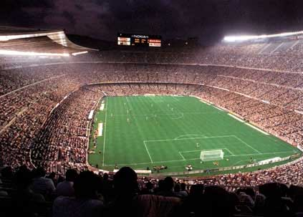
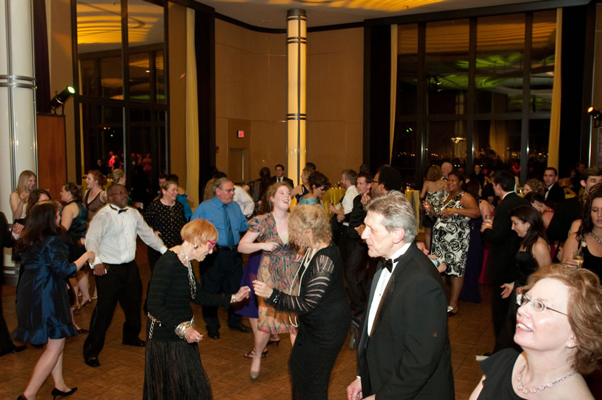
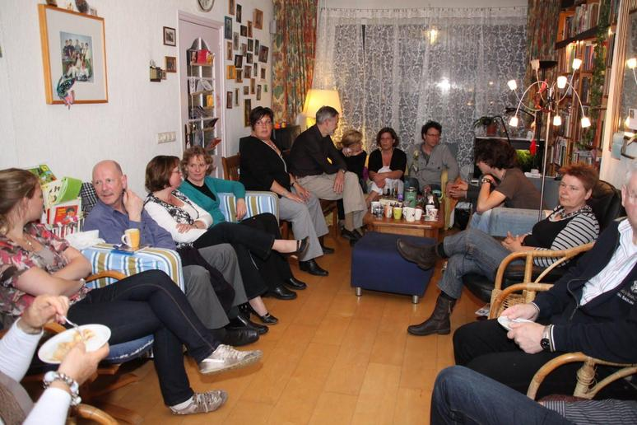
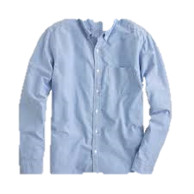
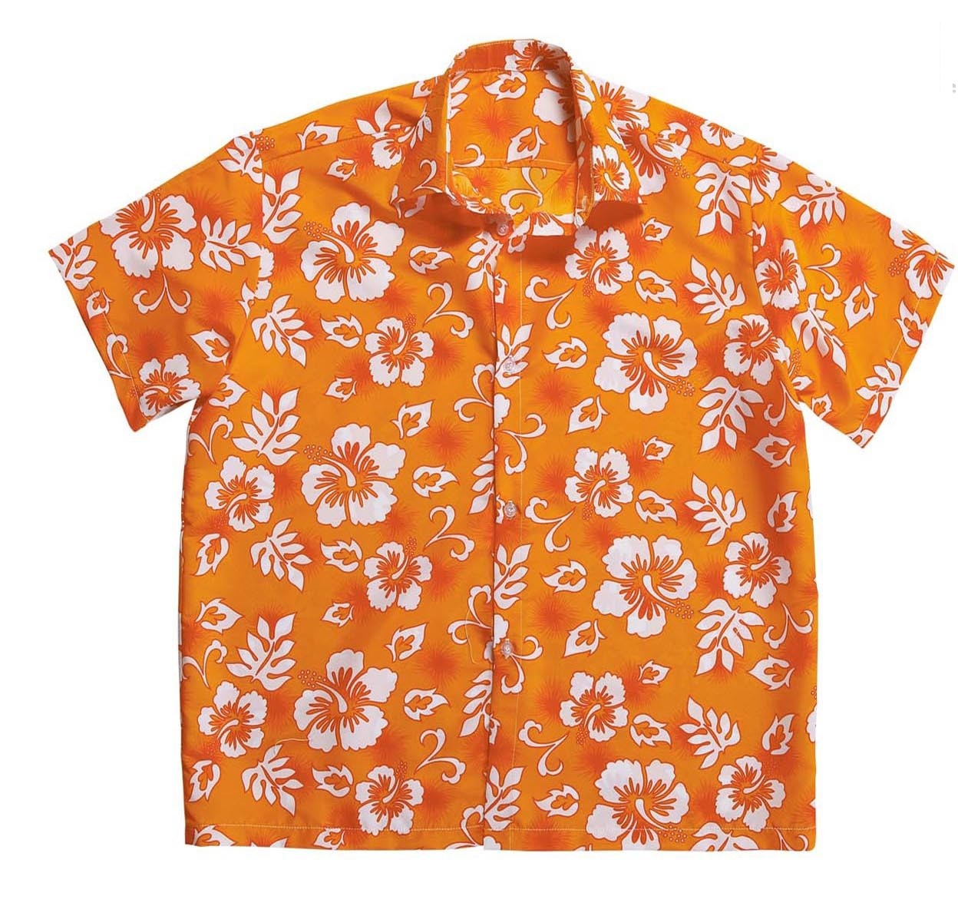
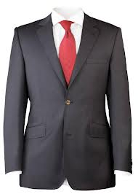
Representative Sets
1 | 0 | 0 | 1 | 0
0 | 0 | 1 | 1 | 0
1 | 1 | 0 | 0 | 0
0 | 0 | 1 | 0 | 0

Slide 11
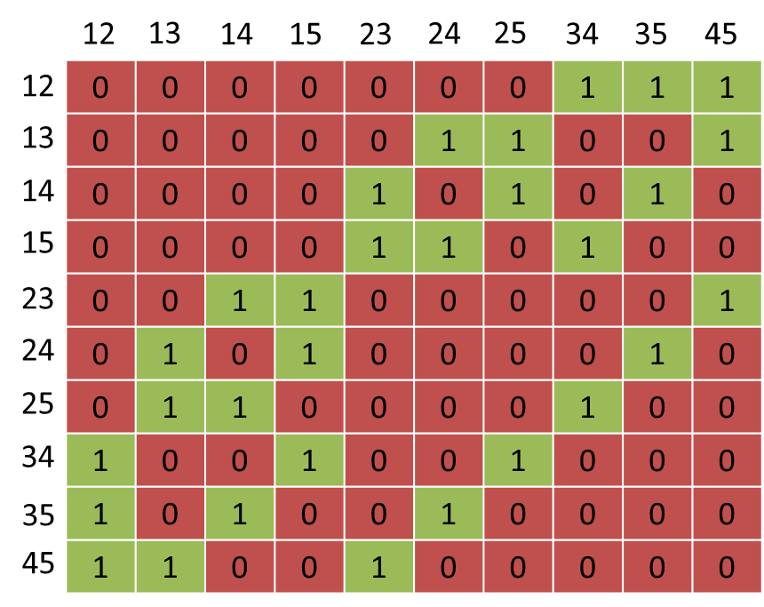
Representative Sets
Thm $k$-path in $O^{∗}(k!)$ time
Assume $k$ odd; guess the middle vertex $v$
Let $𝒜⊆\left({V \atop k/2}\right)$ be all vertex sets of paths
on $⌊k/2⌋$ vertices ending at $v$
Def $𝒜‘⊆𝒜$ is representative for $𝒜$ if:
$∀B∈ \left({V \atop k/2}\right)$: if exists $A∈𝒜$ disjoint from $B$,
then there exists $A^{′}∈𝒜‘$ disjoint from $B$.
Can ensure $\left|𝒜′\right|≤2^{k}$ (Bollobás), can be computed in $O^{∗}(\left|𝒜\right|⋅k!)$ time
Menger: $n!$ steps, best?
Karp: NP-complete
Mohien: $k!$
‘30
‘62
‘72
‘82
‘85
Bellman, Held&Karp: $2^{n}$
Karp: $2^{n}W$ poly space

Slide 12
Color-Coding
Thm $k$-path in $O^{∗}({\left(2e\right)}^{k})$ time
For each vertex $v∈V$, pick $c\left(v\right)∈_{R} \{1,…,k\}$
Def A $k$-path${(v}_{1},…,v_{k})$ is colorful if ${\left\{c\left(v_{1}\right),…,c(v_{k})\right\}=\{1,…,k\}}_{ }$
$\operatorname{Pr}\left[k\text{−}\text{path} {(v}_{1},…,v_{k}\right)$is colorful$]≈{1/e}^{k}$
#colorful $k$-paths from $s$ to $t$ =
$$\sum_{F⊆\{1,…,k\} }{{\left(−1\right)}^{|F|} A_{G\left[\{v∈V:c\left(v\right)∉F\}\right]}^{k−1}\left[s,t\right]}$$
Menger: $n!$ steps, best?
Karp: NP-complete
Mohien: $k!$
‘30
‘62
‘72
‘82
‘85
‘95
Bellman, Held&Karp: $2^{n}$
Karp: $2^{n}W$ poly space
Alon,Yuster,Zwick:${(2e)}^{k}$

Slide 13
Vector-Coding
Thm $k$-path in $O^{∗}(2^{k})$ time
For each vertex $v∈V$, pick $c\left(v\right)∈_{R}ℤ_{2}^{k}$
Def A $k$-path${(v}_{1},…,v_{k})$ is linearly independent if $c\left(v_{1}\right),…,c(v_{k})$ are
$\operatorname{Pr}\left[k\text{−}\text{path} {(v}_{1},…,v_{k}\right)$ is LI$]=1/e$
#LI $k$-paths from $s$ to $t$ $≡_{2}$
$$Orth\left(x\right)≔\{v∈V:〈c\left(v\right),x〉≡_{2}0\}$$
$$\sum_{x∈ℤ_{2}^{k} }{A_{G[Orth\left(x\right)]}^{k−1}\left[s,t\right]}$$
Menger: $n!$ steps, best?
Karp: NP-complete
Mohien: $k!$
‘30
‘62
‘72
‘82
‘85
‘95
‘09
Bellman, Held&Karp: $2^{n}$
Karp: $2^{n}W$ poly space
Alon,Yuster,Zwick:${(2e)}^{k}$
Koutis: $2^{k}W$

Slide 14
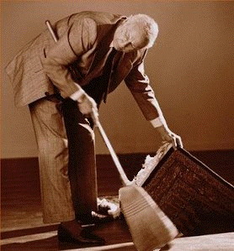
Narrow Sieves
Thm Undirected Hamilton cycle in $O^{∗}({1.66}^{n})$ time
Thm’ Undirected bipartite Hamilton cycle in $O^{∗}(2^{n/2})$ time
0011
a
1
4c3b1a3d
0101
b
2
4c3a1b3d
1001
c
3
1000
d
4
Menger: $n!$ steps, best?
Karp: NP-complete
Mohien: $k!$
Björklund: $1.66^{n}W$
‘30
‘62
‘72
‘82
‘85
‘95
‘09
‘10
Bellman, Held&Karp: $2^{n}$
Karp: $2^{n}W$ poly space
Alon,Yuster,Zwick:${(2e)}^{k}$
Koutis: $2^{k}W$

Slide 15
Part 2: Decomposition via Matchings
Based on
Marek Cygan, Stefan Kratsch, Jesper Nederlof:
Fast Hamiltonicity Checking Via Bases of Perfect Matchings. J. ACM 2018, STOC 2013

Slide 16
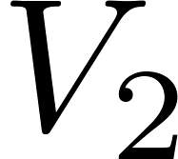
Our Starting Point (back in 2012)
Suppose $S$ is small separator : $V=V_{1}∪S∪V_{2}$ and no edges between $V_{1},V_{2}$
Partitions Hamilton Cycle in $H_{1}∪H_{2}$
Alice knows $G[V_{1}]$
Bob knows $G[V_{2}]$
Alice sends candidates for $H_{1}$
Bob decides if a HC exists
How many candidates must Alice send, in terms of $|S|$?
$$S$$

Slide 17
Our Starting Point (back in 2012)
Suppose $S$ is small separator : $V=V_{1}∪S∪V_{2}$ and no edges between $V_{1},V_{2}$
Partitions Hamilton Cycle in $H_{1}∪H_{2}$
Alice knows $G[V_{1}]$
Bob knows $G[V_{2}]$
Alice sends candidates for $H_{1}$
Bob decides if a HC exists
How many candidates must Alice send, in terms of $|S|$?
0
2
0
$$S$$

Slide 18
Our Starting Point (back in 2012)
Suppose $S$ is small separator : $V=V_{1}∪S∪V_{2}$ and no edges between $V_{1},V_{2}$
Partitions Hamilton Cycle in $H_{1}∪H_{2}$
Alice knows $G[V_{1}]$
Bob knows $G[V_{2}]$
Alice sends candidates for $H_{1}$
Bob decides if a HC exists
How many candidates must Alice send, in terms of $|S|$?
0
2
2
0
0
2
$$S$$

Slide 19
Our Starting Point (back in 2012)
Suppose $S$ is small separator : $V=V_{1}∪S∪V_{2}$ and no edges between $V_{1},V_{2}$
Partitions Hamilton Cycle in $H_{1}∪H_{2}$
Alice knows $G[V_{1}]$
Bob knows $G[V_{2}]$
Alice sends candidates for $H_{1}$
Bob decides if a HC exists
How many candidates must Alice send, in terms of $|S|$?
Naively: $2^{Θ(\left|S\right|⋅\log{|S|})}$ bits.
0
2
2
0
0
2
$$S$$
Answer: ${\left(2+\sqrt{2}\right)}^{|S|}$

Slide 20
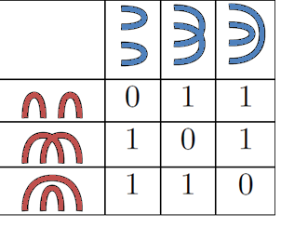
Matchings Connectivity Matrix
For even $t≥2$ and two perfect matchings $P,Q$ of $K_{t}$ define
$$H_{t}[P,Q]=\left\{\begin{aligned}1, \text{if} P∪Q \text{is} \text{a} \text{Hamilton} \text{cycle} \\ &0, \text{otherwise} \end{aligned}\right.$$
Dimensions of $H_{t}$ are $2^{θ(t log t)}$
H₄
Def $𝒫′⊆𝒫$ is representative for $𝒫$ if:
$∀Q$: if exists $P∈𝒫$ with $P∪Q$ HC
then there exists $P′∈𝒫‘$ with $P∪Q$ HC
Obs Any row basis of $H_{t}[𝒫,⋅]$ is representative for $𝒫$.
Lem Given a rank-$r$ factorization $H_{t}=L_{t}R_{t}$ with explicit $L_{t}$,
a representative set of $𝒫$ can be computed in $\left|𝒫\right|r^{ω−1}$ time.

Slide 21
Matchings Connectivity Matrix
Two factorizations $H_{t}$: cut fact. (rank $2^{t−1}$) and matchings fact. (rank $2^{t/2−1}$ )
Def A cut is an unordered partition of $K_{t}$.
Def A cut $\{V_{1},V_{2}\}$ splits a matching $M$ of if for every $\{u,v\}∈M$:
$\left\{u,v\right\}⊆V_{1}$ or $\{u,v\}⊆V_{2}$.
Obs Let $P,Q$ be two perfect matchings. The number of cuts that split both $P$ and $Q$ is $2^{cc\left(P∪Q\right)−1}$.
The Cut Factorization
$$\sum_{cut \{V_{0},V_{1}\}}{\left[\left\{V_{0},V_{1}\right\} \text{splits} P\right]⋅\left[\left\{V_{0},V_{1}\right\} \text{splits} Q\right]}$$
$H_{t}\left[P,Q\right]≡_{2}2^{cc\left(P∪Q\right)−1}$=

Slide 22
Bases of $H_{t}$
Divide $\{1,…,t\}$ into groups:
$$π\left(1\right) \left| π\left(2\right) π\left(3\right)\right| π\left(4\right) π(5) \left| ⋯π\left(t−1\right) \right| π(t)$$
1
0
$ℬ_{t}≔$ matchings using only edges between consecutive groups
1-1 correspondence with ${\left\{0,1\right\}}^{t/2−1}$

Slide 23
Bases of $H_{t}$
Divide $\{1,…,t\}$ into groups:
$$π\left(1\right) \left| π\left(2\right) π\left(3\right)\right| π\left(4\right) π(5) \left| ⋯π\left(t−1\right) \right| π(t)$$
0
1
$ℬ_{t}≔$ matchings using only edges between consecutive groups
1-1 correspondence with ${\left\{0,1\right\}}^{t/2−1}$
The Matching Factorization
$$\sum_{x∈{\left\{0,1\right\}}^{t/2−1} }{\left[P∪ℬ_{t}^{π}\left(x\right) is HC\right]⋅[Q∪ℬ_{t}^{π}\left(\overline{x}\right) is HC]}$$
$H_{t}\left[P,Q\right]≡_{2}$

Slide 24
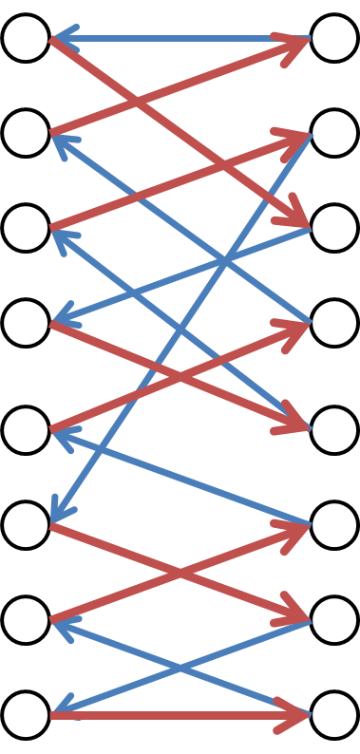
Applications
Thm Undirected HC in ${n\left(2+\sqrt{2}\right)}^{pw}poly(pw)$ time.
Thm Symmetric TSP in ${n\left(2+2^{ω/2}\right)}^{pw}poly(pw)$ time.
Thm Bipartite Directed Hamilton Cycle in ${1.888}^{n}$.
Let $𝒫$ be all pm’s in red graph, $𝒬$ all pm’s in blue graph
$$\sum_{\begin{aligned}P∈𝒫 \\ Q∈𝒬\end{aligned}}{H_{t}\left[P,Q\right]≡_{2}}\sum_{\begin{aligned}P∈𝒫 \\ Q∈𝒬\end{aligned}}{\sum_{x∈{\left\{0,1\right\}}^{n/2−1}}{\left[P∪B(x) is HC\right]⋅}\left[P∪B(\overline{x}) is HC\right]}$$

Slide 25
Applications
Thm Undirected HC in ${n\left(2+\sqrt{2}\right)}^{pw}poly(pw)$ time.
Thm Symmetric TSP in ${n\left(2+2^{ω/2}\right)}^{pw}poly(pw)$ time.
Thm Bipartite Directed Hamilton Cycle in ${1.888}^{n}$.
Let $𝒫$ be all pm’s in red graph, $𝒬$ all pm’s in blue graph
$$\sum_{\begin{aligned}P∈𝒫 \\ Q∈𝒬\end{aligned}}{H_{t}\left[P,Q\right]≡_{2}}\sum_{x∈{\left\{0,1\right\}}^{n/2−1}}{\left(\sum_{P∈𝒫}{\left[P∪B(x) is HC\right]}\right)\left(\sum_{Q∈𝒬}{\left[Q∪B\left(\overline{x}\right) is HC\right]}\right)}$$

